Slide 1

Students&Companies
RASD/DD project
Andrea Bellani, Alessandro Capellino

Slide 2
Project information
Members
Andrea Bellani:
personal code: 10733192
e-mail: andrea1.bellani@mail.polimi.it
Alessandro Capellino:
personal code: 10744332
e-mail: alessandro.capellino@mail.polimi.it
Project repository URL: https://github.com/ImAndreaBellani/BellaniCapellino

Slide 3
RASD
Requirements And Specification Document

Slide 4

Goals and assumptions
GOALS
[G1] students and companies establish contacts for doing internships
[G2] internships selections can be monitored and supported by the system
[G3] ongoing internships can be monitored from the system

Slide 5

Goals and assumptions
DOMAIN ASSUMPTIONS
[D1] Users must have a reliable internet connection
[D2] Information contained in the CVs are truthful and do not conflict each other
[D3] Company fill the form about internship advice with only information compatible with their business decisions and not conflicting each other
[D4] Company correctly enters the answers provided by the student during the interview into the system
[D5] When users registers, they register with an active email address that belongs to them
[D6] Uploaded CVs are written in EuroPass format

Slide 6



The world and the machine
Magari mettere il requirement della notifica mail
Students&Companies
Notification
Selection
process config.
advice search
intern. monitoring
contact
intern. monitoring
Internship performing
CV creation
Interviews
Internship
preparation
students
companies

Slide 7

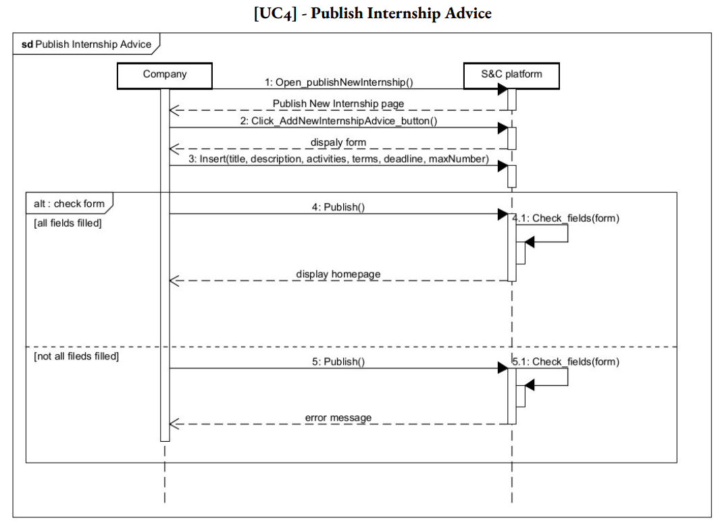
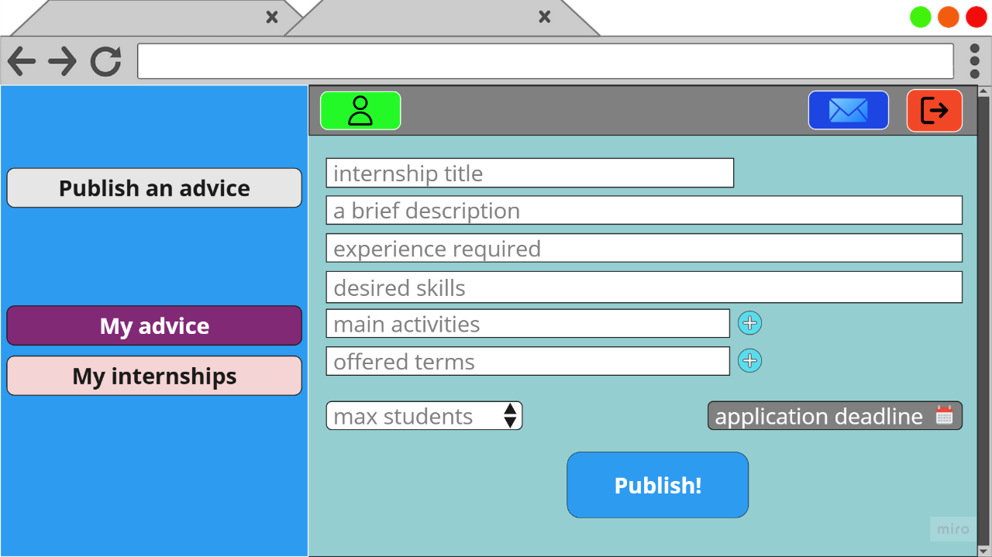
Company advice publish

Slide 8
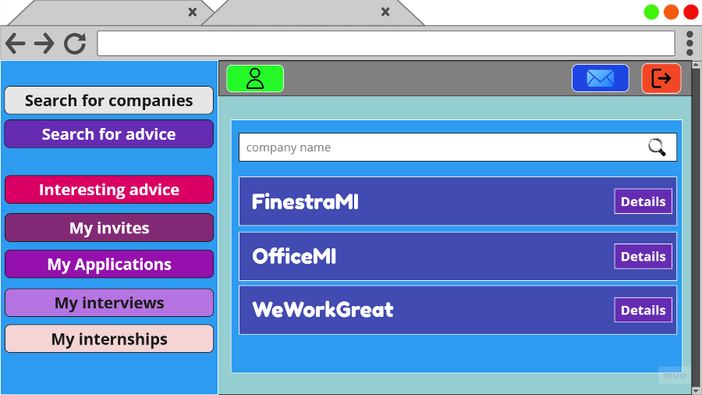
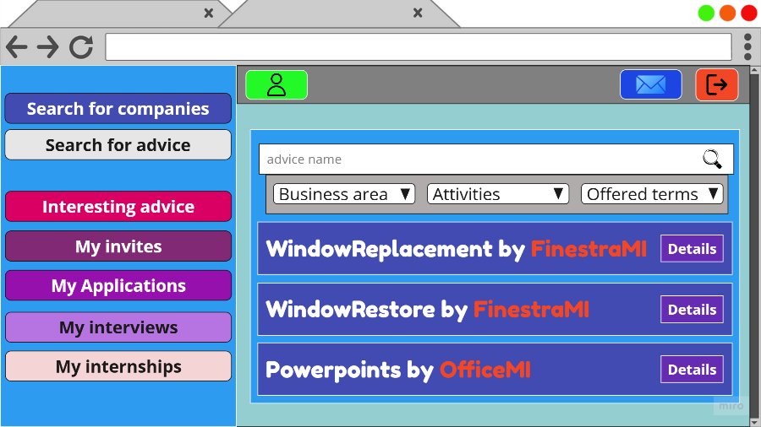
Student proactive search
[R10401] the system allows students to search internships advice by name The system shall act as a search engine to present also the names of the advice that are similar to the searched one
[R10402] the system allows students to search companies by name (and also to see the complete list of registered companies) and then access to their profile
[R10403] the system allows students to filter the results they searched (e.g. ”only paid internships”, ”only companies located in Lombardy”)

Slide 9
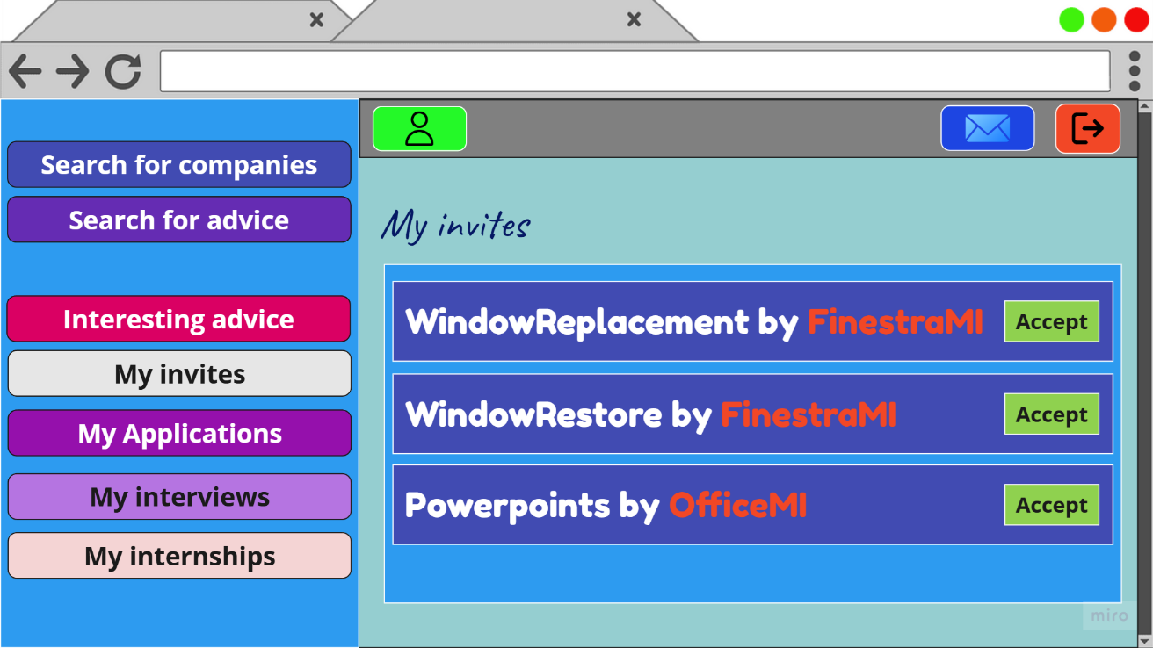
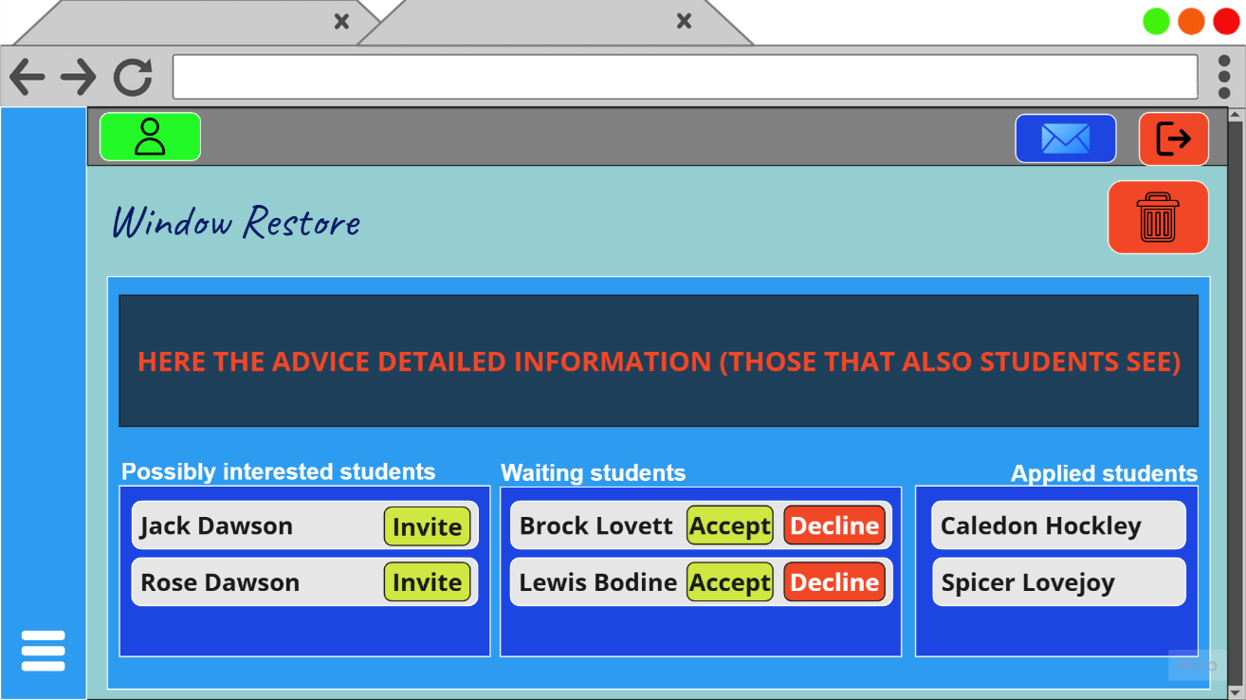


Recommendation mechanism

Slide 10
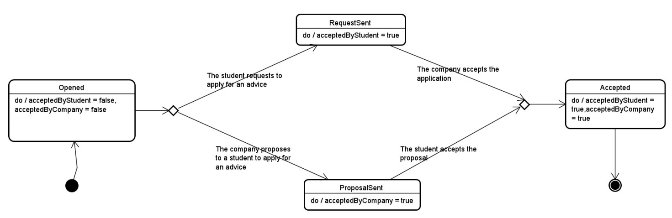
Recommendation mechanism

Slide 11
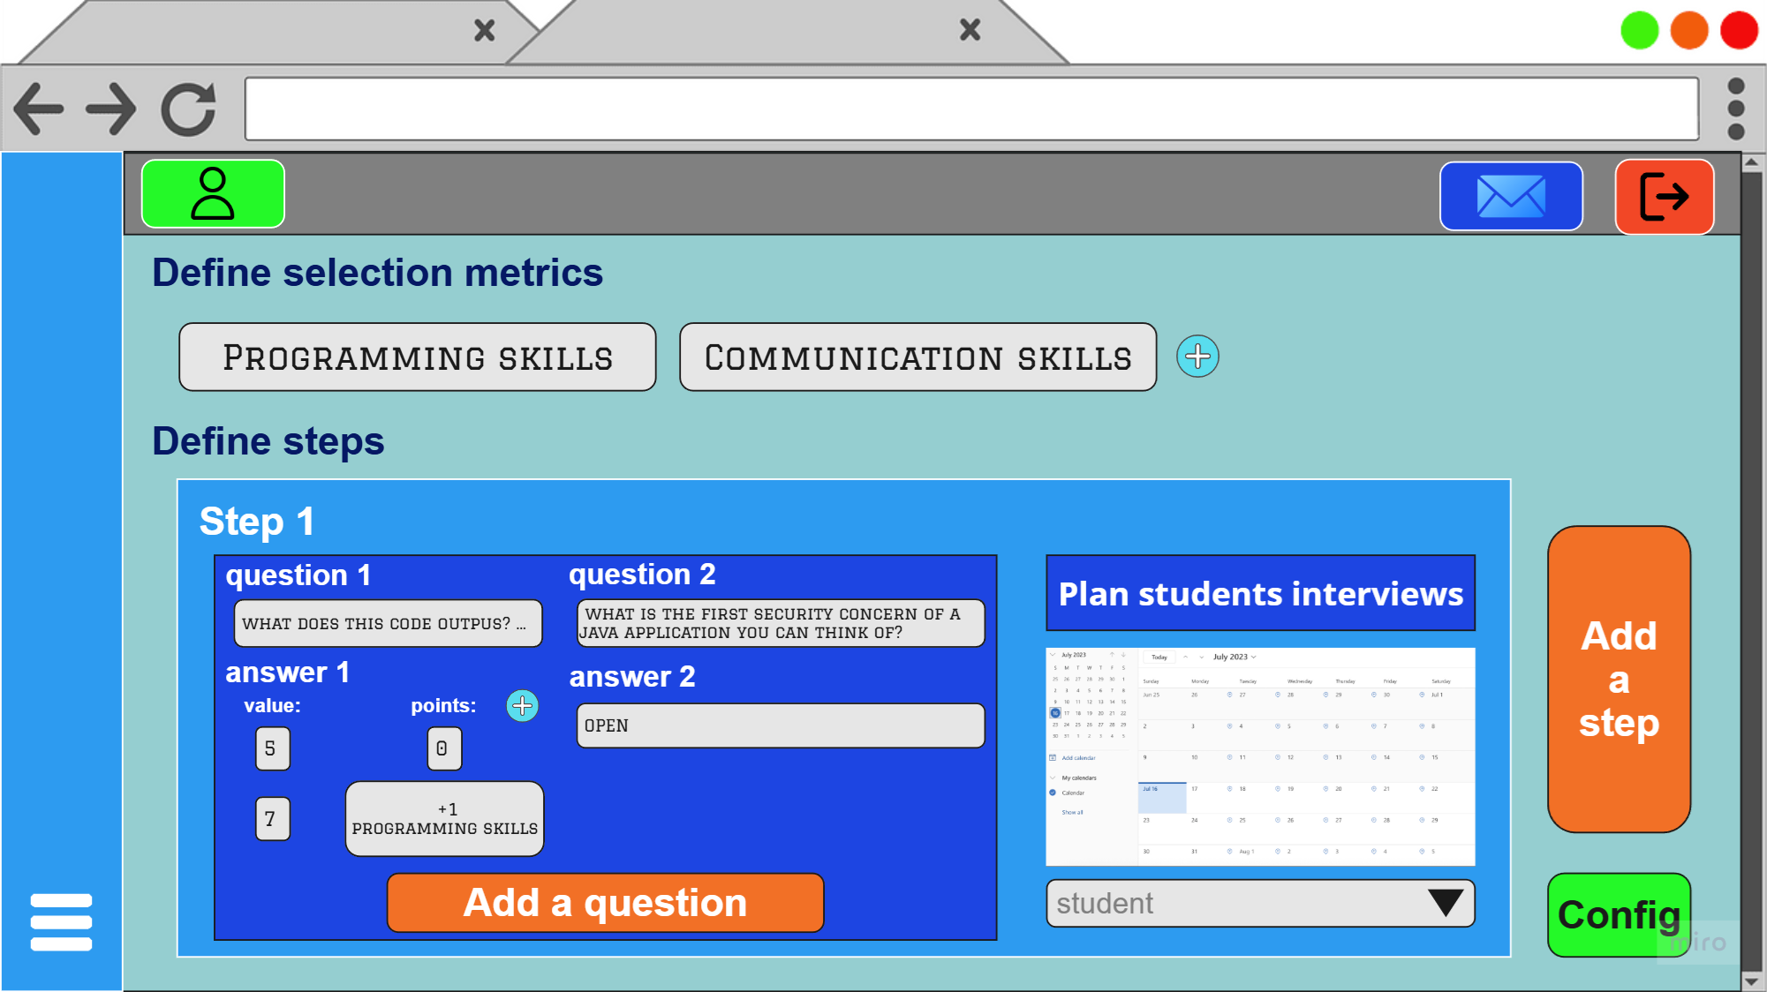
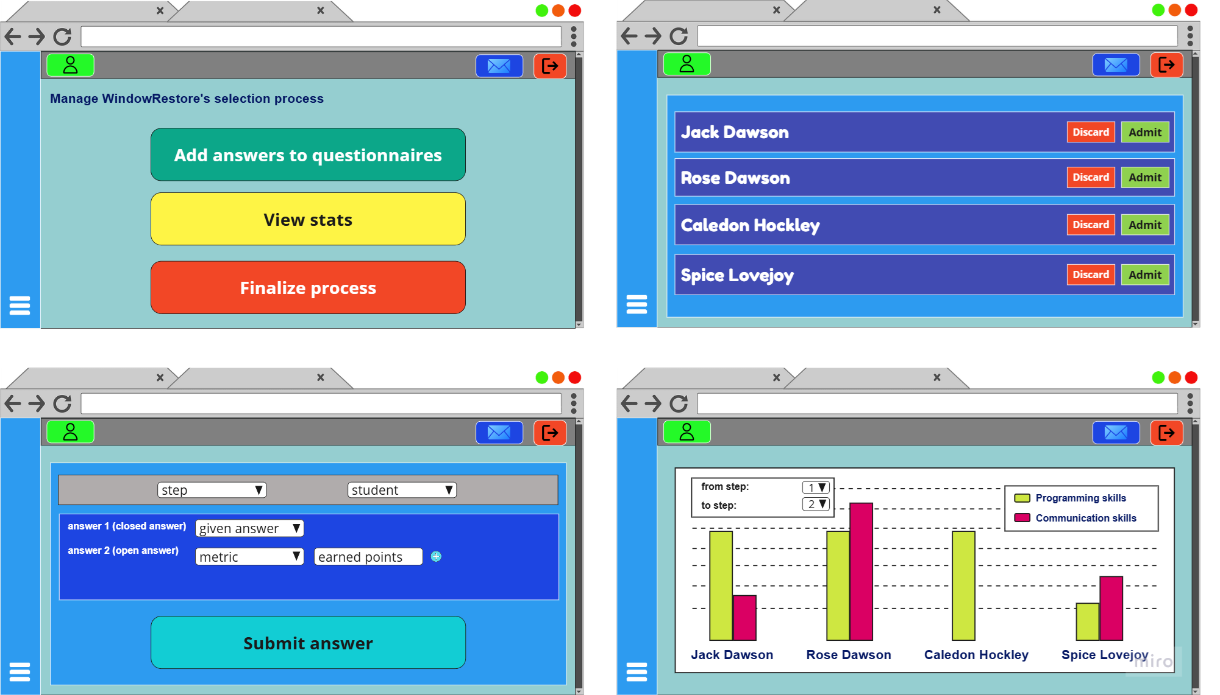
Selection process management

Slide 12
Selection process management
[R20101] when the deadline for an internship advice is expired, the system allows the company to set up the selection process by specifying for each step, the relative questionnaire (with metrics for each question) and the date in which provide it to a student (dates may differ between different students)
[R20202] the system allows companies insert students answers into the system
[R20203] the system automatically calculates the scores of questionnaire closed answers
[R20204] the system allows companies to manually insert scores for questionnaire open answers
[R20205] the system allows companies to visualize and compare selections scores
[R20206] in any selection phase, the system allows companies to discard a student currently involved in the selection process (discarded students are removed by the selection process) ANALOGUE FOR ACCEPTANCE

Slide 13
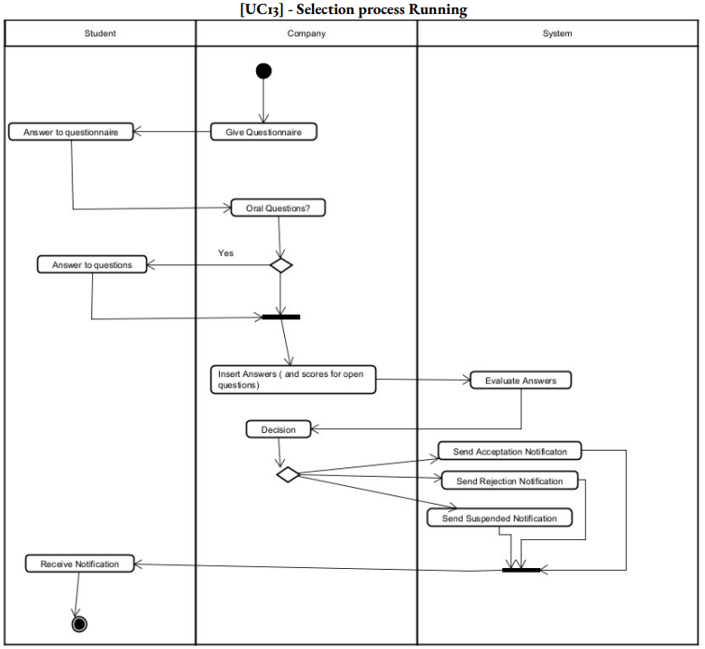
Selection process management

Slide 14
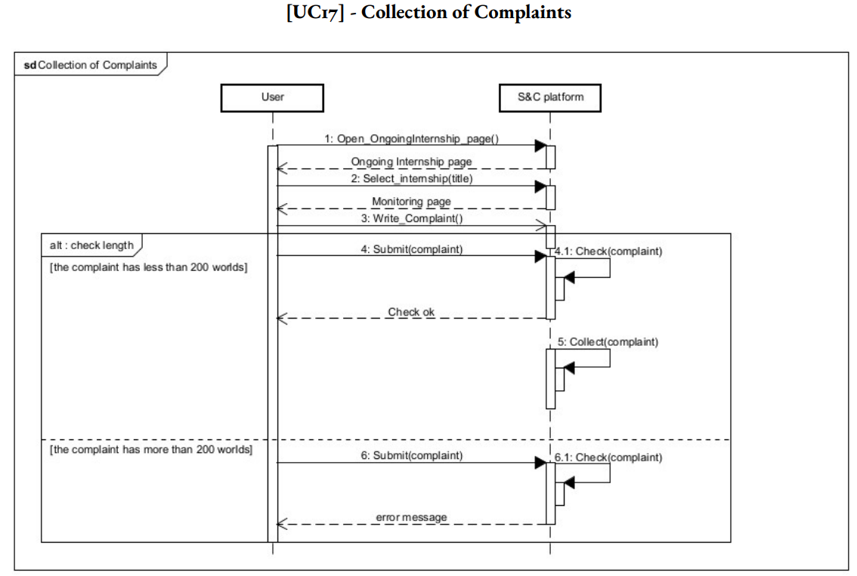
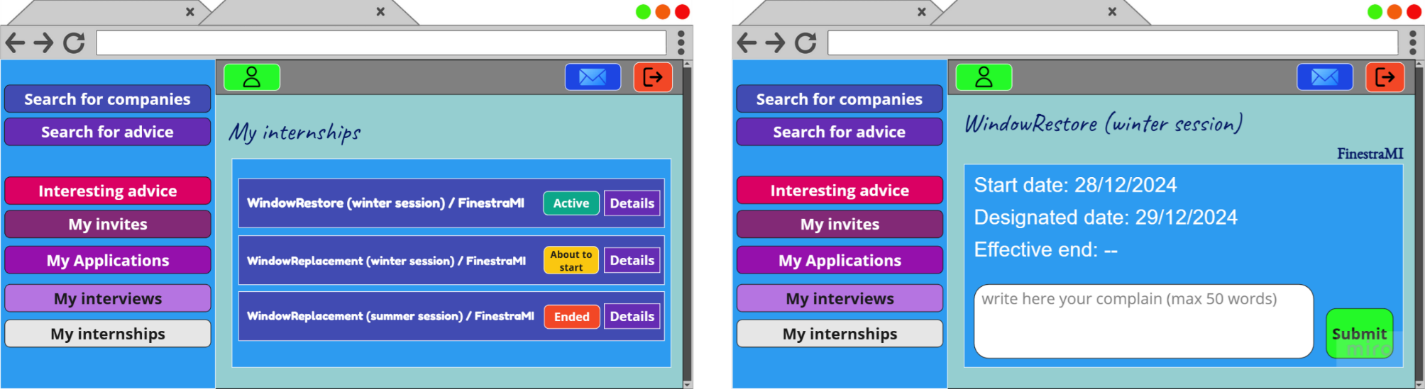

Ongoing internship monitoring

Slide 15
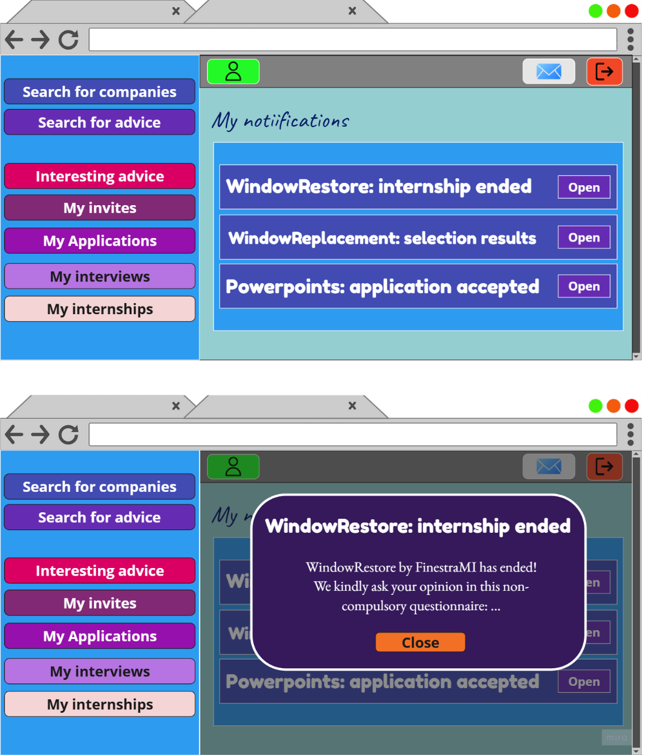

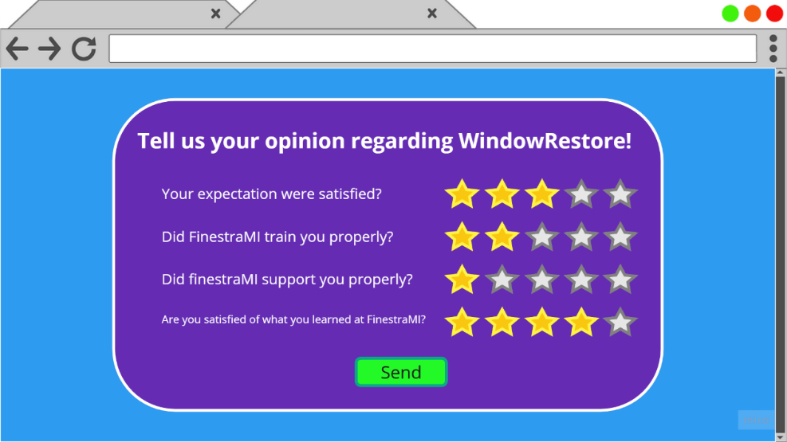
Feedbacks
[R11102] when a company ends a selection process, the system provides to it a non-compulsory questionnaire regarding its experience (in the context of that selection process)
[R11201] when a student concludes an internship, the system provides to him/her a non-compulsory questionnaire regarding him/her experience (in the context of that internship) and in the meantime it provides to the internship company an analogue questionnaire also non-compulsory

Slide 16

Our modeling with Alloy 6
What we modeled
applications and withdrawals (temporal simulation)
selection process

Slide 17
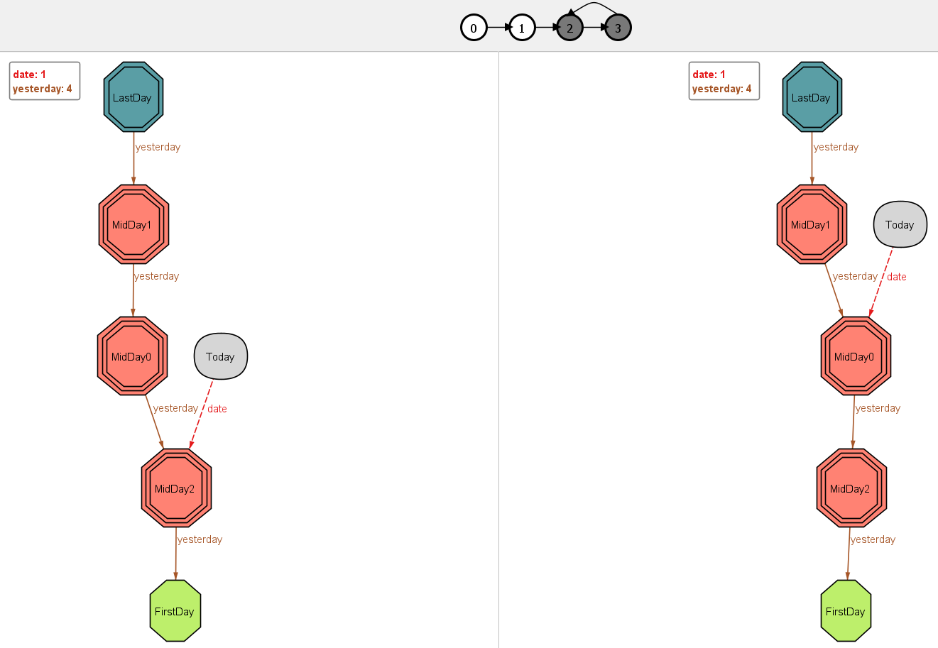
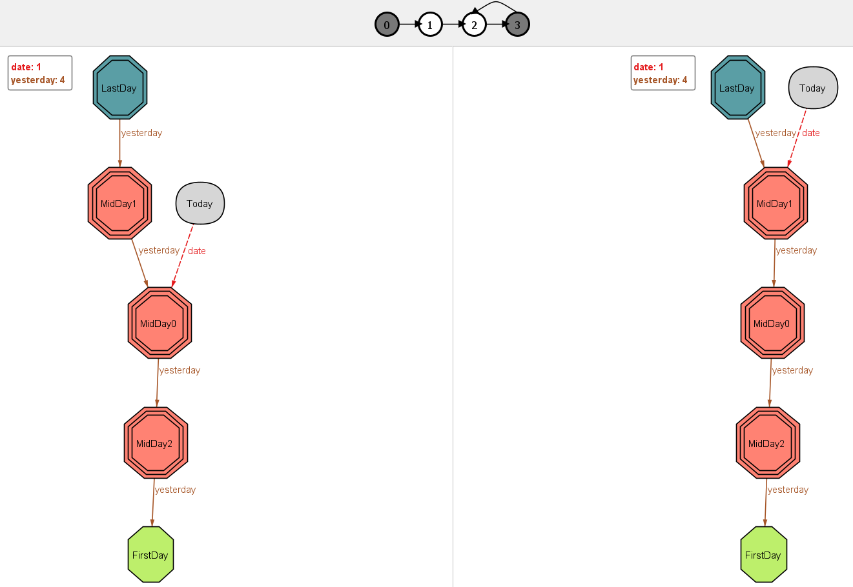

Slide 18
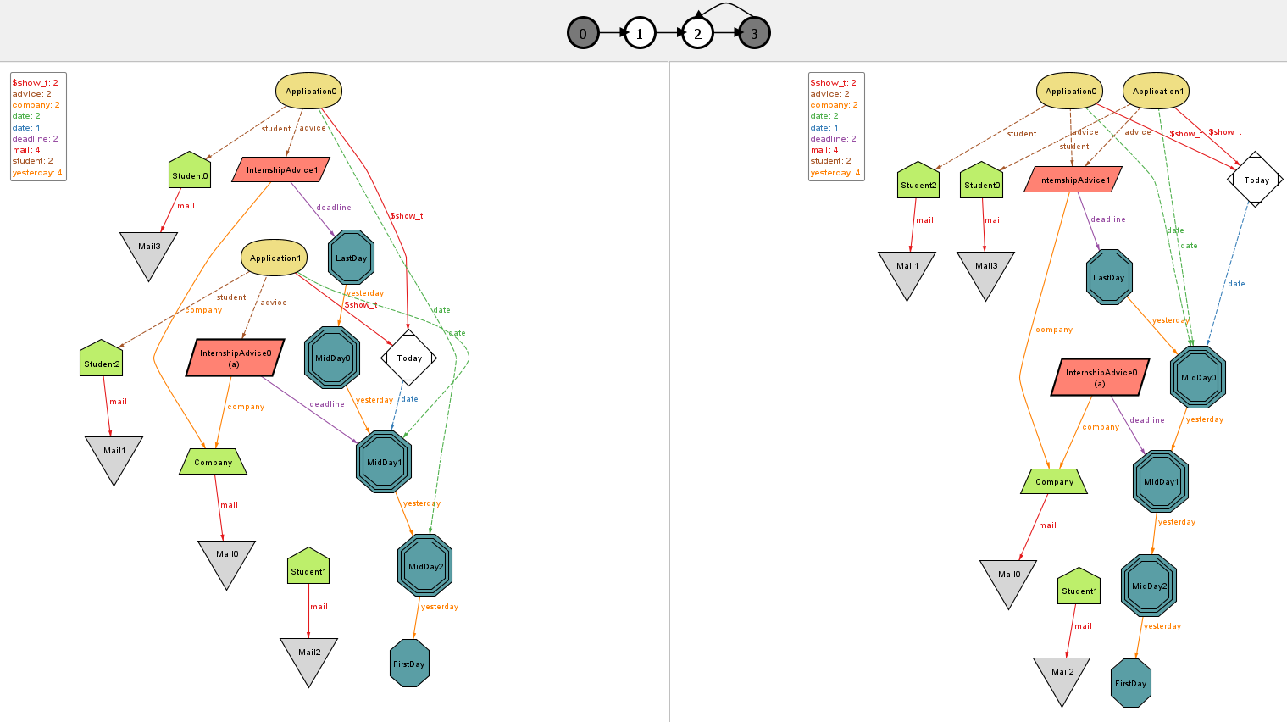

Slide 19
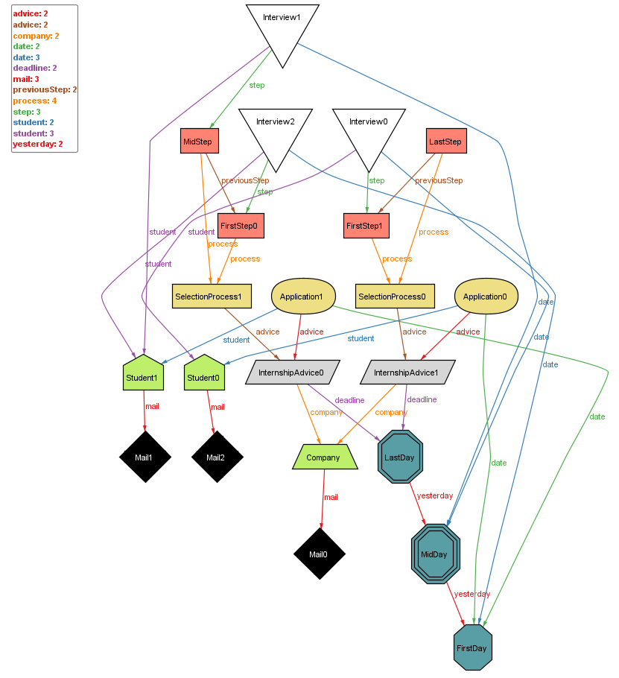

Slide 20
DD
Design Document

Slide 21

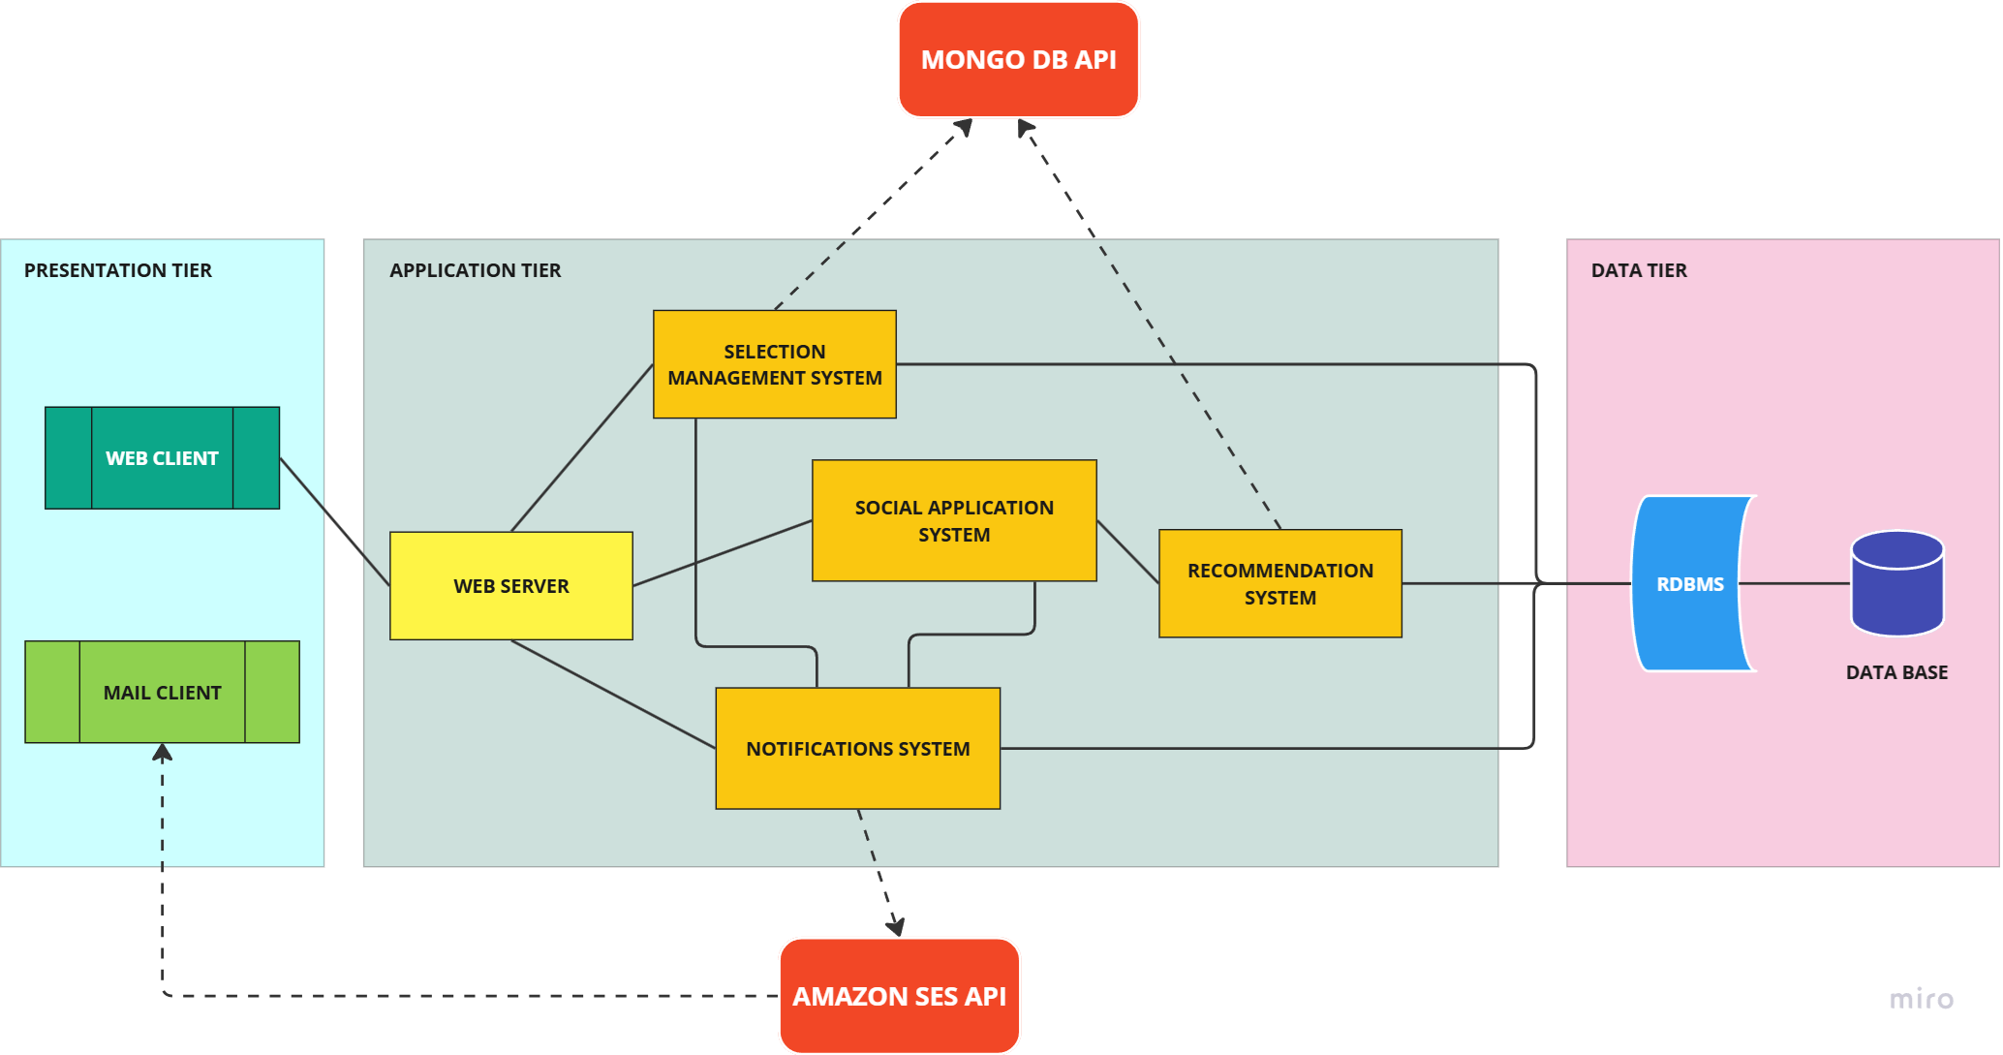
High-level architecture

Slide 22

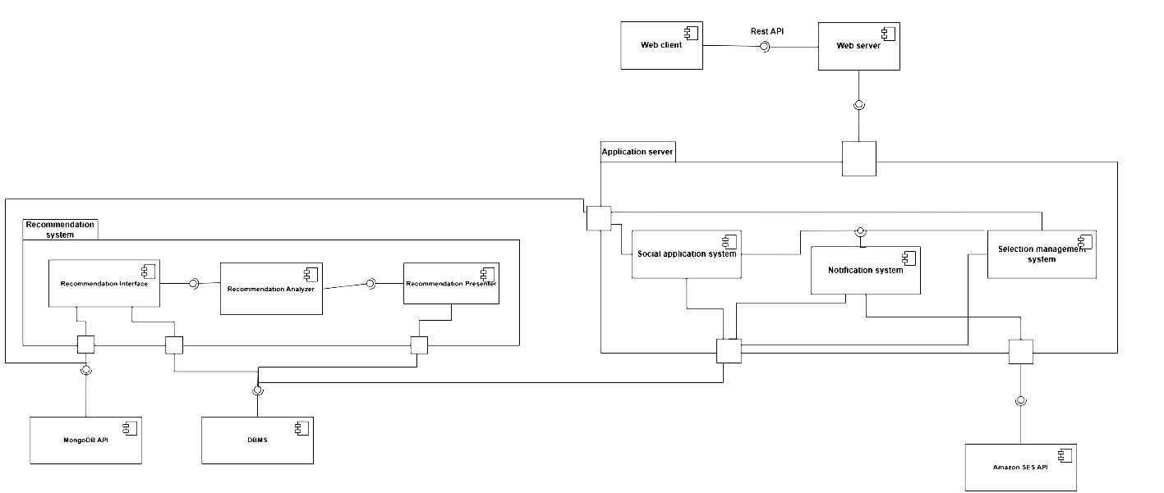
Component diagram (macro-components)

Slide 23
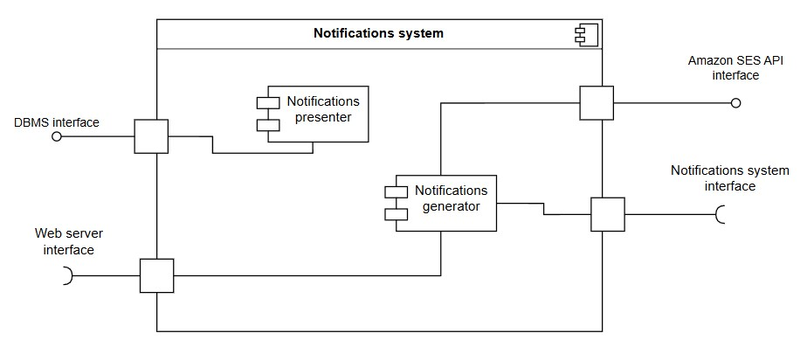
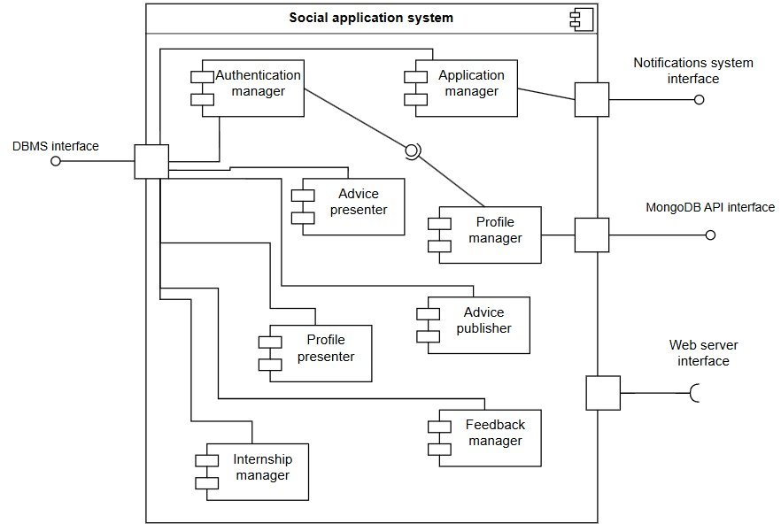
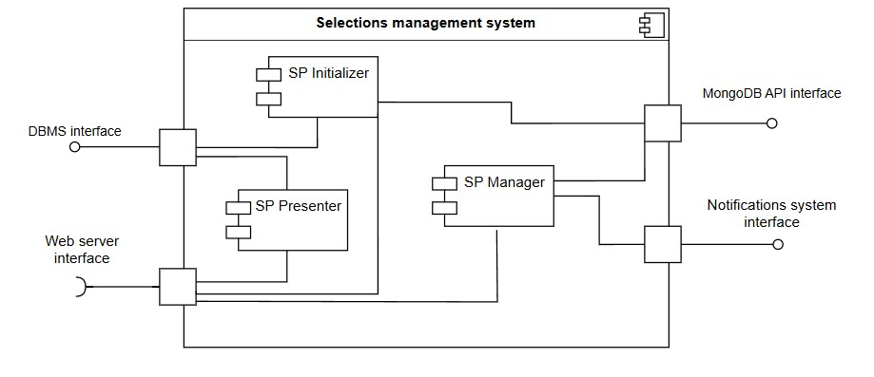

Slide 24

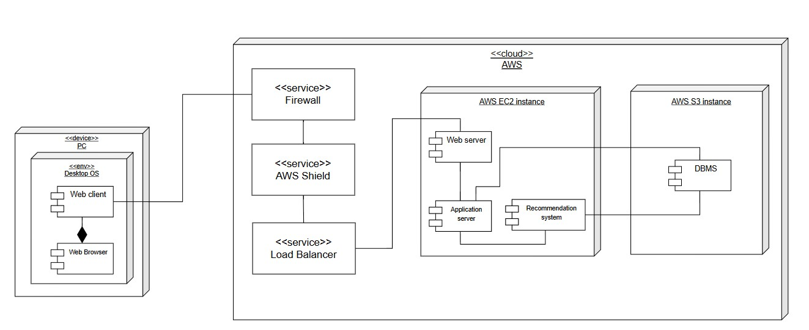


Deployment view
HTTPS
DDOS prevention

Slide 26

Integration Plan
Data Layer
Presentation Layer
Mancano alcuni componenti (es. AdvicePresenter)
AuthenticationManager, ProfileManager
Recommendation system, Notification management system
Selection process management system
FeedbackManager, InternshipManager

Slide 27
Thank you for your attention
Written by: Andrea Bellani, Alessandro Capellino

